Slide 1
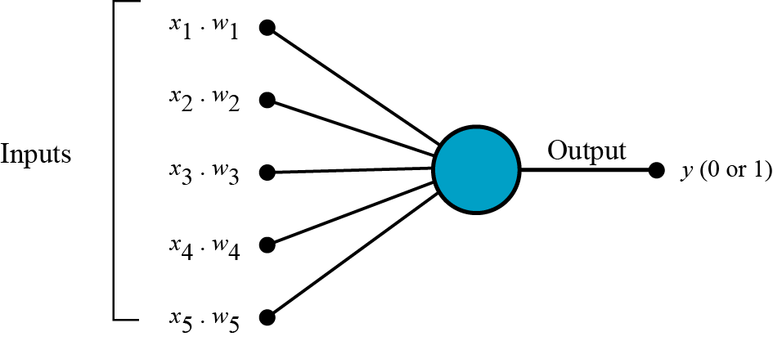
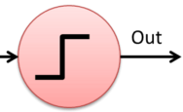
Σ
Linear
operation
Non-Linear
operation

Slide 2
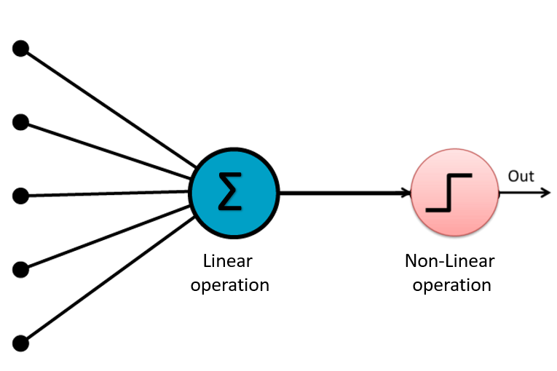
Output 1
Layer 1
Output N

